Slide 1
Activity 9 – Playing Notes by Image Processing
Kenneth M. Leo
Score: 11 / 10 (only able to do the rest bonus not the envelope)

Slide 2
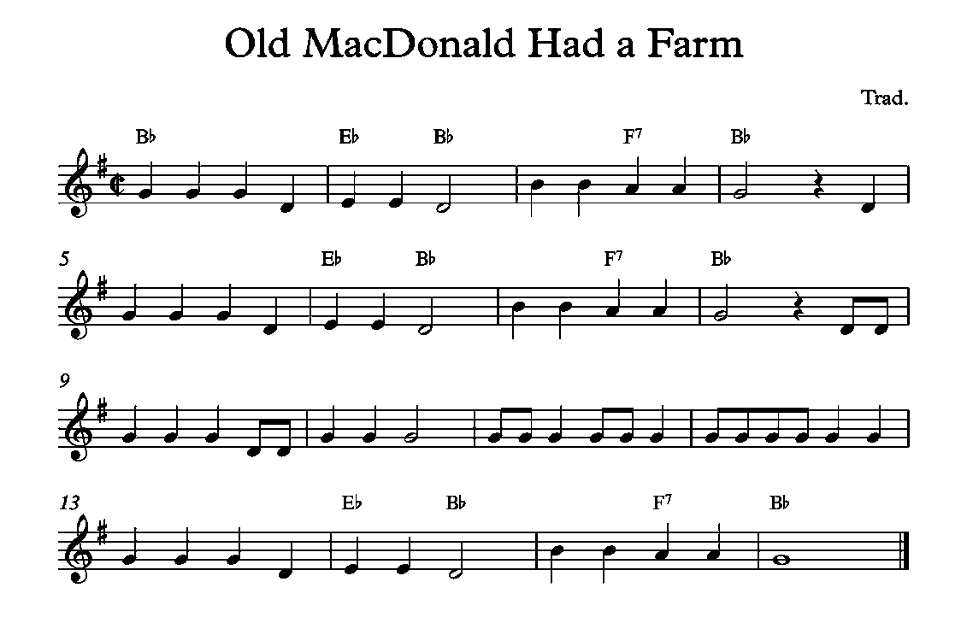
In this activity, I used this simple music sheet of ‘Old MacDonald Had a Farm’ which contains quarter, half, and full notes, as well as rests.
To start, I segmented the sheet into four different parts and I will just simply show you what I did for the first part because the same process will be done to the other 3 parts.

Slide 3
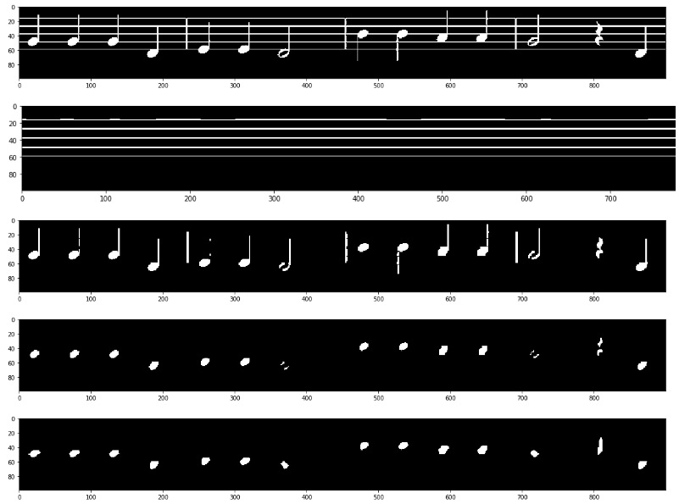
What I first did was to binarize the music sheet. From the first image, we see that the zeros are the background and the notes and staff lines have values of one.
Next, I separated the staff line (by eroding the image with a 1 x 40 horizontal line) and the notes (by eroding the image with a 3 x 2 rectangle). Now, we don’t need the bars on the notes so I removed it by eroding the notes with a 1 x 4 vertical line.
Lastly, I filled the half notes and the rest by eroding then dilating the fourth image with an ellipse. Now we see that we only have the notes and the rest (which looks weird).

Slide 4
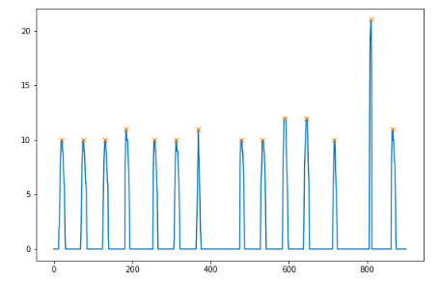
To identify the rest, I created a 1D histogram of the notes horizontally by summing all the vertical values. We see that the rest has a very high value compared to the notes (which is because of the fact that it remained a ‘vertical blob’ after the erosion and dilation done to the music sheet. Because of this I was able to separate the rest from the notes.
Now to identify the half note from the quarter note from the whole note, these 3 have different areas. So first I found the area of the notes and if the area is less than 70, then it is a half note. If it is between 85-100, it is a quarter note, and if it around 120-150 then it is a whole note.

Slide 5
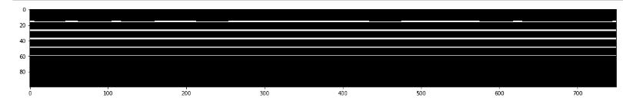
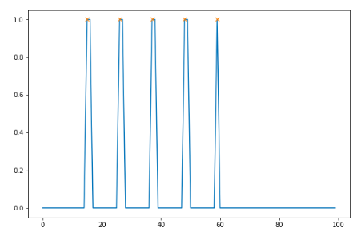
To find the frequency of the note, I first located the pixel location of the staff lines and put its appropriate frequencies. Then I find the distance between the two staff lines and the midpoint also corresponds to another frequency. Essentially, I just made a look-up table using the staff line to create it (pixel-frequency conversion).
Now, I measured the centroid of the note blobs and then used the look-up table to find which frequency corresponds to the pixel value of the centroid.
Finally, to play the note, I created sine waves using the frequency and the time duration I found.

Slide 6

PLAY ME!
I concatenated the individual sines created and then used the wavio package in Python to convert these sine waves into sound.
(I will still attach the .wav file just in case the button on the left does not work).

